Slide 1

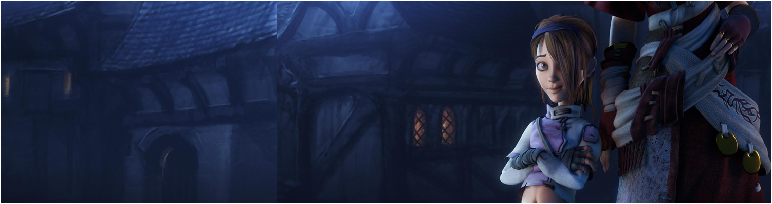

Lecture 8: FPS Games in Unity pt III
GAM150: Game Programming Essentials
BA Game Development

Slide 2
Last Time:
Peer Review
Introduction to Game AI in Unity

Slide 3
Today’s session:
Physics in Unity
Break
Object lifespan as a weapon
Spawning NPCs

Slide 4
Physics in Unity

Slide 5
Physics in Unity
Like a lot of Unity’s systems, physics is based on physical modelling
Mass, velocity & gravity
Implemented by PhyX -> off-loaded to GPU
Scope for lots of physics

Slide 6
Physics in Unity
What is Physics in video games
Physics is often used to describe anything that moves, collides or takes graphical damage
This is not the case, physics is concerned with these things:
1. General motion
2. collisions / intersections between objects
3. conservation of momentum
4. simulation stability during 1 + 2 + 3
Everything else that’s described as ‘physics’ is not physics under this definition
Particularly destruction modelling
Often just geometry replacement or division

Slide 7
Physics in Unity
Physics in video games
1. General Motion
This is all the Newtonian mechanics we learnt at school in Physics and/or Applied maths
As we saw last time, we don’t really need to worry too much about the underlying maths / physics
Newton’s 4 laws of motion
Concerned primarily with the relationships between:
Velocity
Acceleration
Time
Friction
Last time we looked briefly at mass, we will look at this again shortly

Slide 8
Physics in Unity
Physics in video games
2. Collisions / intersections between objects
This is essentially a pure maths problem of geometry in space
Typically, physics representations of game objects will use simple geometry:
Euclidian solids (spheres, cylinders, cubes, capsules etc)
(player controller with capsule collider)
Maths of intersections is well-understood
Creates optimised collision detection
Game geometry will often use mesh colliders
Too much like hard work to create physics models of complex environments
Processing hardware is (generally) fast enough to deal with it ☺

Slide 9
Physics in Unity
Physics in video games
3. Conservation of momentum
This is essentially a physics problem
Momentum = mass x velocity
Again, saw mass last time as a definable value
For us, we need to think about the mass & velocity of objects and gravity within the games we make
This is a design issue
Games do not have to exist with Earth-like gravity if we want gameplay where things fall or rise more quickly/slowly

Slide 10
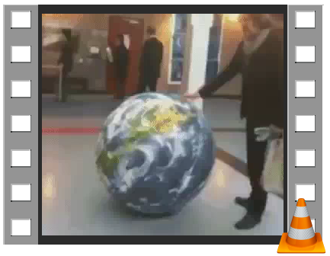
Physics in Unity
Physics in video games
3. conservation of momentum in those collisions

Slide 11
Physics in Unity
Physics in video games
3. conservation of momentum in those collisions
From physics at school
When objects collide, momentum is conserved
https://www.physicsclassroom.com/class/momentum/Lesson-2/Momentum-Conservation-Principle
What does this mean
We need to think about how heavy [mass] game objects are so we get believable interactions
We also need to think about how much force to give objects to get them moving at speeds we want
Impulses required for Rigidbody player

Slide 12
Physics in Unity
Physics in video games
4. simulation stability during 1 + 2 + 3
Aka the hard bit
If you have a strong background in maths and physics, writing a physics engine sounds like a fun thing to do
However, stability is difficult
Lots of youtube videos will testify to this
Challenge is that physics is done periodically
Rather than with continuous updates, so it can be tricky to capture when objects first collide
This results in a lot of internal force and objects that fly into space / don’t behave believably

Slide 13
Physics in Unity
Physics in video games
4. simulation stability during 1 + 2 + 3
Unity will deal with most of this
Think about the size and speed of gameobjects
If things are small enough and fast enough, there’s a good chance they will go through each other
Can see this in the platform game in making the falling collider deep enough to deal with player freefall
Can use continuous collision detection & Interpolation in Rigidbody to deal with this
Physics is either cheap or accurate ;)

Slide 14
Physics in Unity
Physics in raycasting

Slide 15
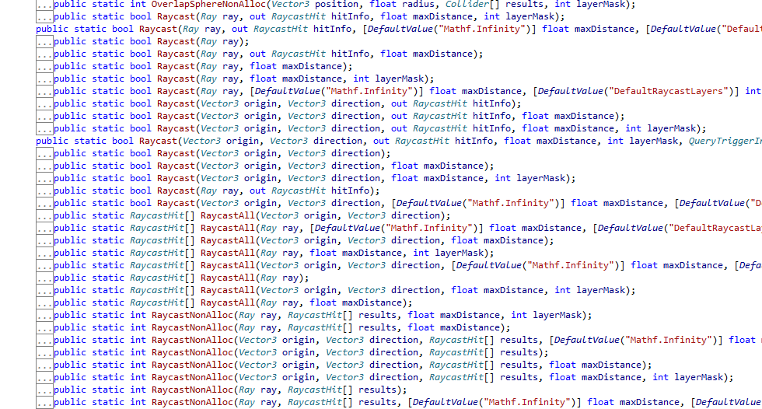
Physics in Unity
Physics in raycasting
We saw last week that we can use Physics.Raycast to pick objects in the scene
There’s lots of flavours of Raycast to experiment with

Slide 16
Physics in Unity
Physics in raycasting
Last time, we looked at
Raycast(screen pos)
Click navigation destinations on map with mouse
Raycast(world pos, dir)
Check if a baddie could ‘see’ the player

Slide 17
Physics in Unity
Physics in raycasting
We saw last week that we can use Physics.Raycast to pick objects in the scene
There’s lots of flavours of Raycast to experiment with
This means:
Raycasting is fundamental to ‘doing things’ in games
There’s lots of different things you can do with raycasting
There’s a lot of scope for failure

Slide 18
Physics in Unity
Physics in raycasting
This time, we want to work out what the player is looking at (as a starting point to shooting stuff)

Slide 19
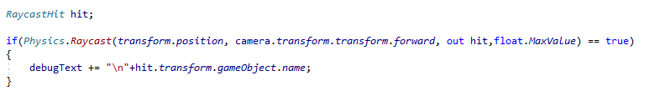
Physics in Unity
Physics in raycasting
Approach 1: 00.Raycasting
Use player’s position and camera forward direction to cast a ray
On success, add the name of the object to the debugtext

Slide 20
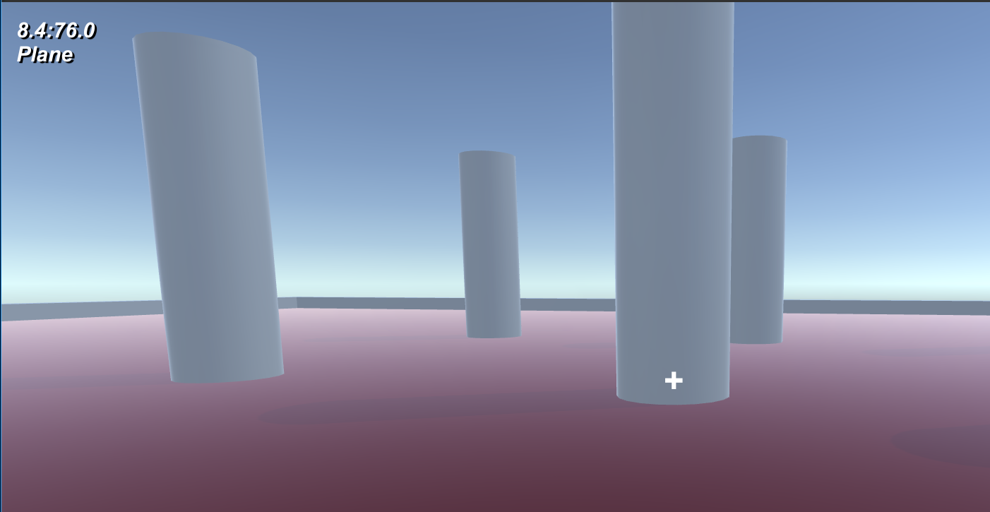
Physics in Unity
Physics in raycasting
Approach 1: 00.Raycasting
Use player’s position and camera forward direction to cast a ray
Get some false positives

Slide 21
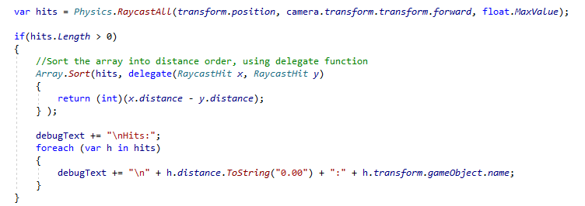
Physics in Unity
Physics in raycasting
Approach 2: 01.Raycasting
Use player’s position and camera forward direction to cast a ray and get all the hits. Then sort them on distance

Slide 22
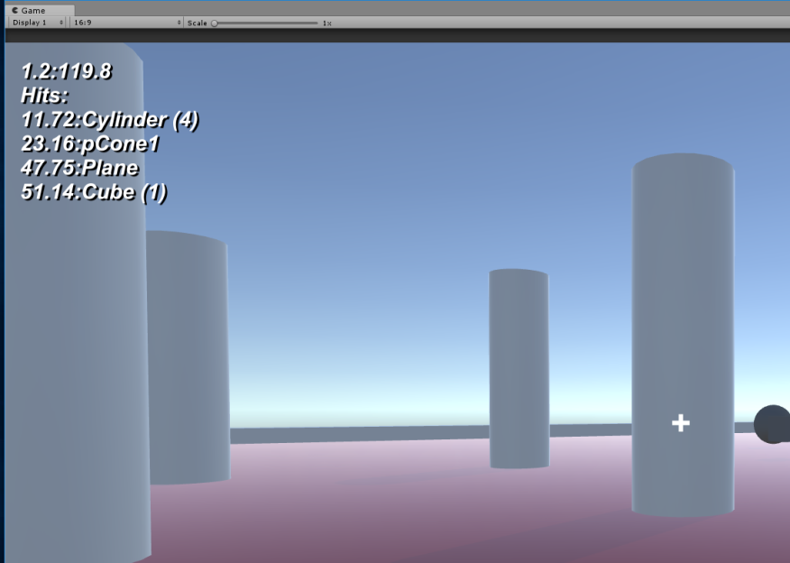
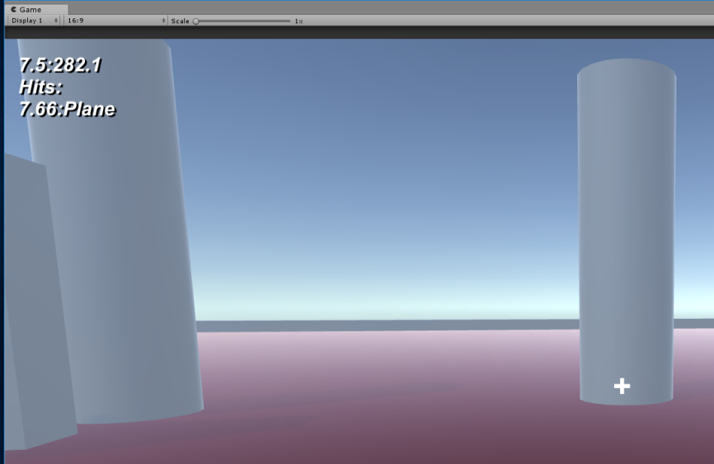
Physics in Unity
Physics in raycasting
Approach 2: 01.Raycasting
Use player’s position and camera forward direction to cast a ray and get all the hits. Then sort them on distance
Still get false positives ☹ ☹

Slide 23
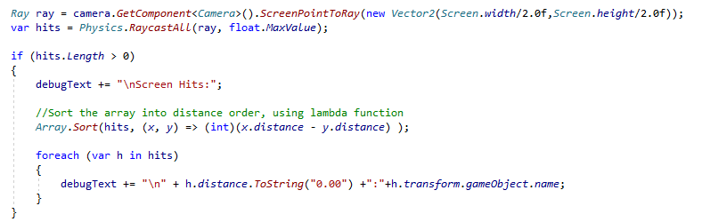
Physics in Unity
Physics in raycasting
Approach 3: 02.Raycasting
Use UI cross hairs and camera forward direction to cast a ray and get all the hits. Then sort them on distance

Slide 24
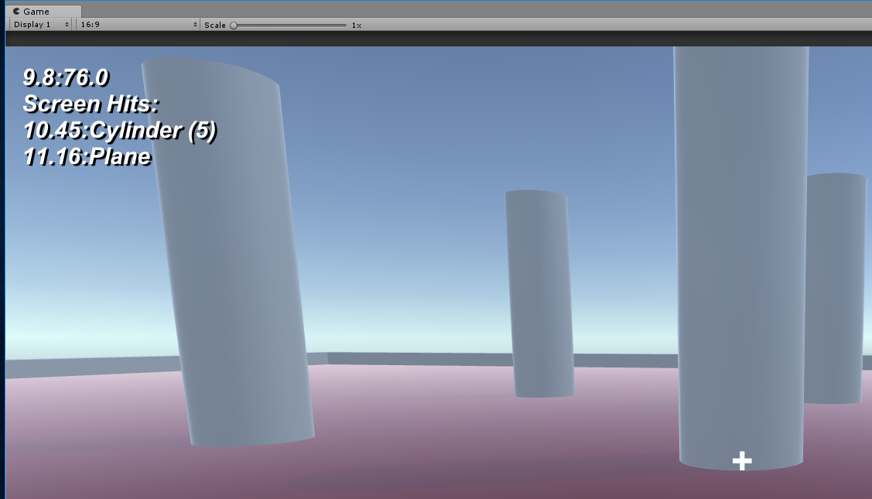
Physics in Unity
Physics in raycasting
Approach 3: 02.Raycasting
Use UI cross hairs and camera forward direction to cast a ray and get all the hits. Then sort them on distance
We have something that’s nice and accurate

Slide 25
Physics in Unity
Physics in raycasting
What can we learn from this?
1. using crosshairs is by far the coolest approach
2. Unity provides lots of different functionality for different *use cases*
We need to select the correct functionality for our situation
There’s a lot of scope for thinking that Unity is broken. More often than not, it’s developer error

Slide 26
Physics in Unity
The raycast / impulse weapon

Slide 27
Physics in Unity
The raycast / impulse weapon
Let’s take what we’ve made with the object picking raycast and add an impulse to ‘shoot’ the object into space

Slide 28
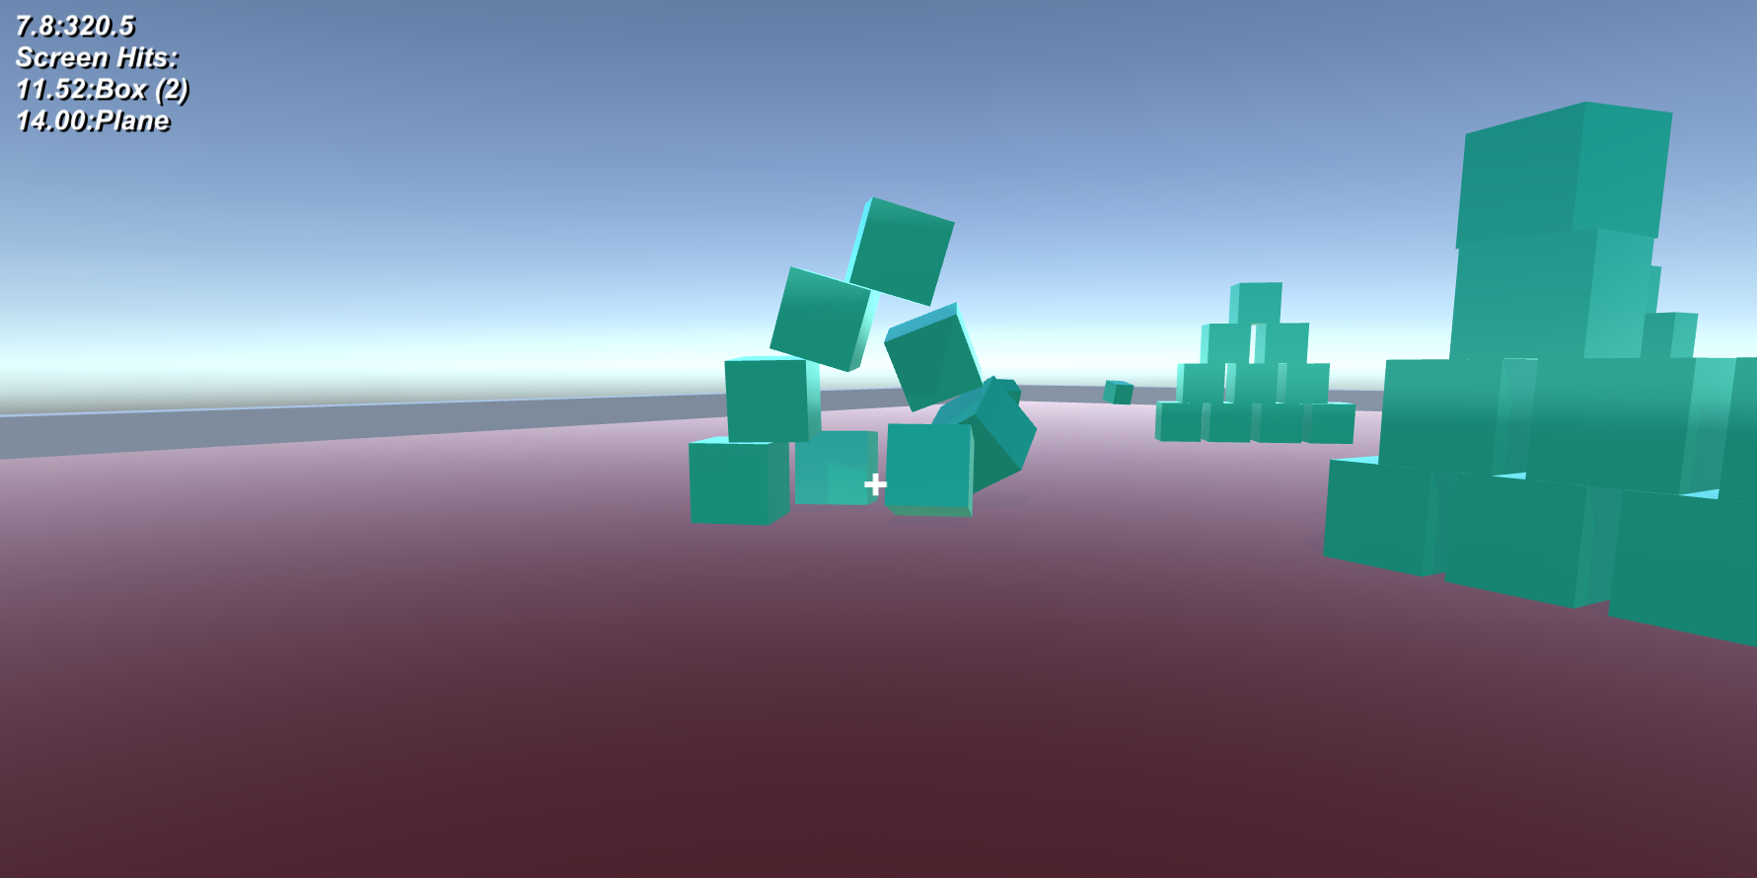
Physics in Unity
The raycast / impulse weapon
03.Raycast Rifle

Slide 29
Physics in Unity
The raycast / impulse weapon
Let’s take what we’ve made with the object picking raycast and add an impulse to ‘shoot’ the object into space
To do:
See if the mouse button has been pressed
Raycast, if we have a hit and it has a rigidbody component
Add a force to the hit’s rigidbody in the direction of the ray as an impulse
Add some torque to make it spin

Slide 30
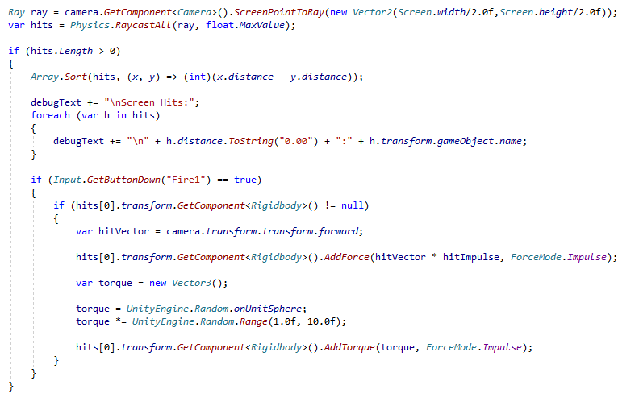
Physics in Unity
The raycast / impulse weapon
03.Raycast Rifle

Slide 31
Physics in Unity
The raycast / impulse weapon
03.Raycast Rifle
Exactly the same as the previous raycast picking example

Slide 32
Physics in Unity
The raycast / impulse weapon
03.Raycast Rifle
To do:
See if the mouse button has been pressed
If we have a hit and it has a rigidbody component
Add a force to the hit’s rigidbody in the direction of the ray as an impulse
Add some torque to make it spin

Slide 33
Physics in Unity
The raycast / impulse weapon
Experimentation:
hitImpulse
This is the amount of force (ooomph) that the object will receive
Mass of scene objects
This relates to the hitImpulse as force = mass x velocity
Bigger masses will take more force to move
More force will move things more
hitVector
This is the angle that is applied to the impulse and (should) give the direction of travel
Torque settings
How much spin do you want and how do you want spin to work
Level settings
How much stuff do you want to play with
Do you want anything to be immune to physical actions?

Slide 34
Physics in Unity
The object weapon

Slide 35
Physics in Unity
The object weapon
Lets make objects weapons rather than just apply force to things

Slide 36
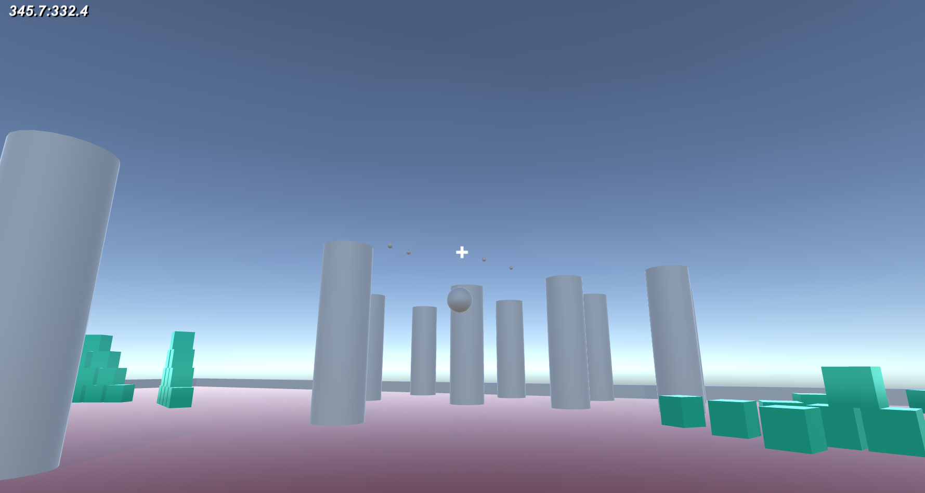
Physics in Unity
The object weapon
04.Physics Weapon

Slide 37
Physics in Unity
The object weapon
Lets make objects weapons rather than just apply force to things
To do:
See if the mouse button has been pressed
Create a new grenade in front of the player
Add a force to the grenade in the direction of the ray as an impulse

Slide 38
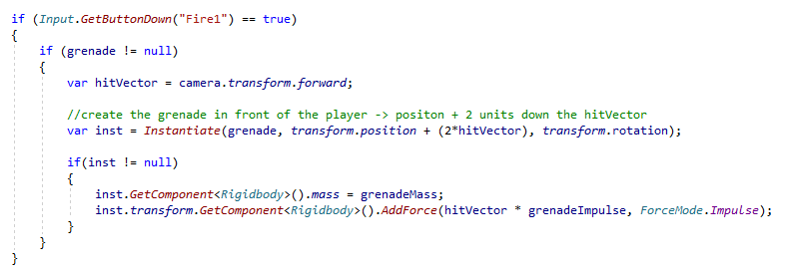
Physics in Unity
The object weapon
Lets make objects weapons rather than just apply force to things

Slide 39
Physics in Unity
The object weapon
Lets make objects weapons rather than just apply force to things
Instantiate
Clone an object at a given position and orientation
I’ve set up the grenade as a prefab and referenced in the player script
https://docs.unity3d.com/ScriptReference/Object.Instantiate.html

Slide 40
Physics in Unity
The object weapon
Lets make objects weapons rather than just apply force to things
Instantiate
Make sure the creation position isn’t the same as the player
I’ve taken the player’s position and added 2 x the camera’s forward direction vector to move it in front of the player
https://docs.unity3d.com/ScriptReference/Object.Instantiate.html

Slide 41
Physics in Unity
The object weapon
Lets make objects weapons rather than just apply force to things
Assuming instantiate returns a new object
Give it a mass
Add a force in the direction of the camera forward and multiply it by a value to make it move
Grenade Mass and Impulse are exposed into the inspector so you can get values that ‘make sense’

Slide 42
Physics in Unity
The object weapon
Lets make objects weapons rather than just apply force to things
Like the impulse rifle, we need to work out what values of mass and impulse make sense for the object weapon to ensure that the weapons work properly with the game world

Slide 43
Break

Slide 44
Object lifespan as a weapon

Slide 45
Object lifespan as a weapon
Destroying objects

Slide 46
Object lifespan as a weapon
Destroying objects
To make a ‘proper’ grenade, it should only do damage when it explodes
And it should only explode when it hits something

Slide 47
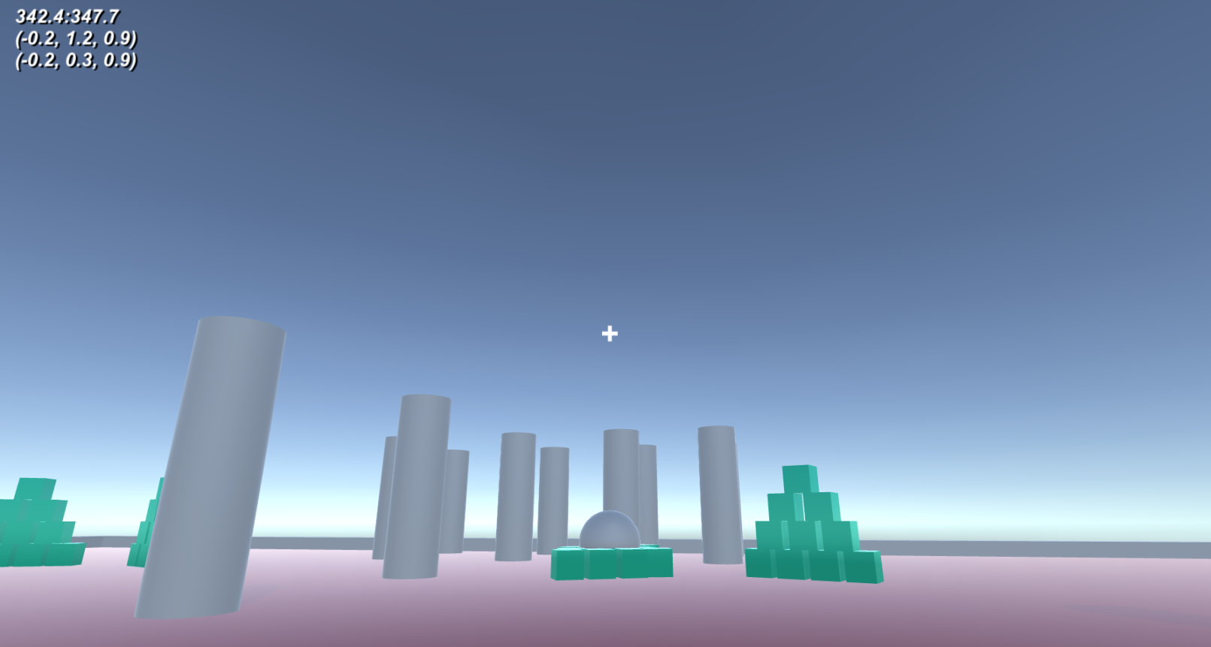
Object lifespan as a weapon
Destroying objects
05. Exploding Damage

Slide 48
Object lifespan as a weapon
Destroying objects
To make a ‘proper’ grenade, it should only do damage when it explodes
This means we need to create a new object that will do damage
Or apply more impulses as an area effect
And the grenade will be light enough to not knock things over
And it should only explode when it hits something
The grenade will be light enough to not knock things over

Slide 49
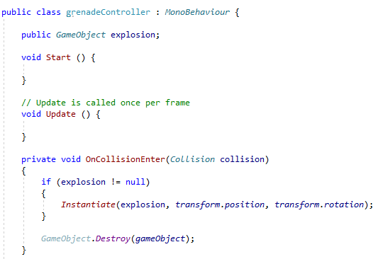
Object lifespan as a weapon
Destroying objects
And it should only explode when it hits something
The grenade will be light enough to not knock things over
Add a grenadeController script that will deal with hitting things

Slide 50
Object lifespan as a weapon
Destroying objects
And it should only explode when it hits something
The grenade will be light enough to not knock things over
Add a grenadeController script that will deal with hitting things
When the grenade has OnCollisionEnter() called, it will destroy itself
However, it will create a new explosion first, using the same approach as the player making grenades (a prefab that is instanticated)

Slide 51
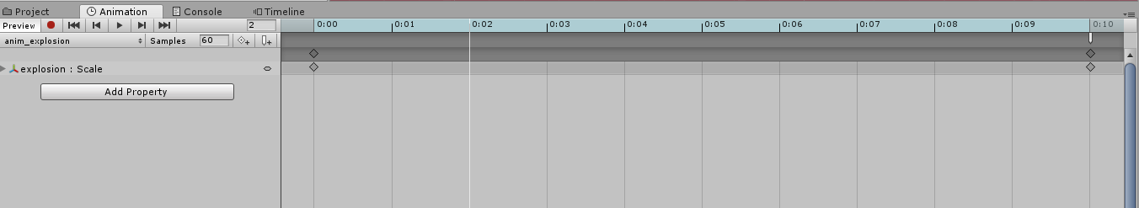
Object lifespan as a weapon
Destroying objects
To make a ‘proper’ grenade, it should only do damage when it explodes
To make the explosion, I have a sphere that is animated over time
It gets bigger (scale) and then disappears
There’s an animation event at the end of the anim to make it all work

Slide 52
Object lifespan as a weapon
Destroying objects
To make a ‘proper’ grenade, it should only do damage when it explodes
ExplosionController
When the explosion is exploding, anything it collides with will need to get a impulse applied to it
When the anim event happens, the explosion will need to ‘die’, just like the grenade

Slide 53
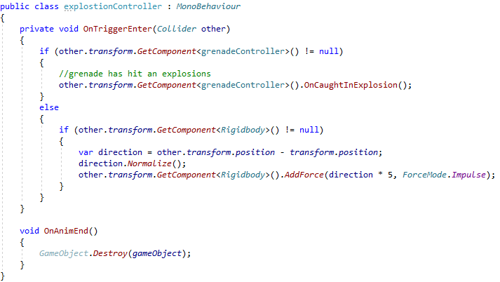
Object lifespan as a weapon
Destroying objects
To make a ‘proper’ grenade, it should only do damage when it explodes
ExplosionController
When the explosion is exploding, anything it collides with will need to get a impulse applied to it

Slide 54
Object lifespan as a weapon
Destroying objects
To make a ‘proper’ grenade, it should only do damage when it explodes
ExplosionController
When the explosion is exploding, anything it collides with will need to get a impulse applied to it
For added ‘realism’, if a grenade goes through an explosion, it will explode via OnCaughtInExplosion()

Slide 55
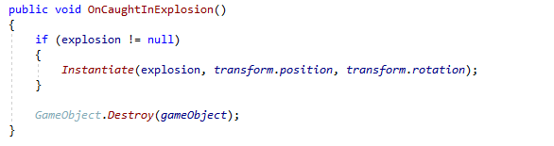
Object lifespan as a weapon
Destroying objects
To make a ‘proper’ grenade, it should only do damage when it explodes
ExplosionController / grenadeController
When the explosion is exploding, anything it collides with will need to get a impulse applied to it

Slide 56
Object lifespan as a weapon
Destroying objects
To make a ‘proper’ grenade, it should only do damage when it explodes
ExplosionController
When the anim event happens, the explosion will need to ‘die’, just like the grenade

Slide 57
Object lifespan as a weapon
Destroying objects
Obviously, the visual fidelity of the explosions can be improved (see Jamie next week with particle systems)
However, blast damage is key (and fun)

Slide 58
Spawning NPCs

Slide 59
Spawning NPCs
Create a demo that:
Adds baddies to the game world with LMB
Removes them with RMB
Baddies will
Find somewhere to go to
Go there
Change colour when the mouse is on them
Has a control script that deals with adding and removing baddies

Slide 60
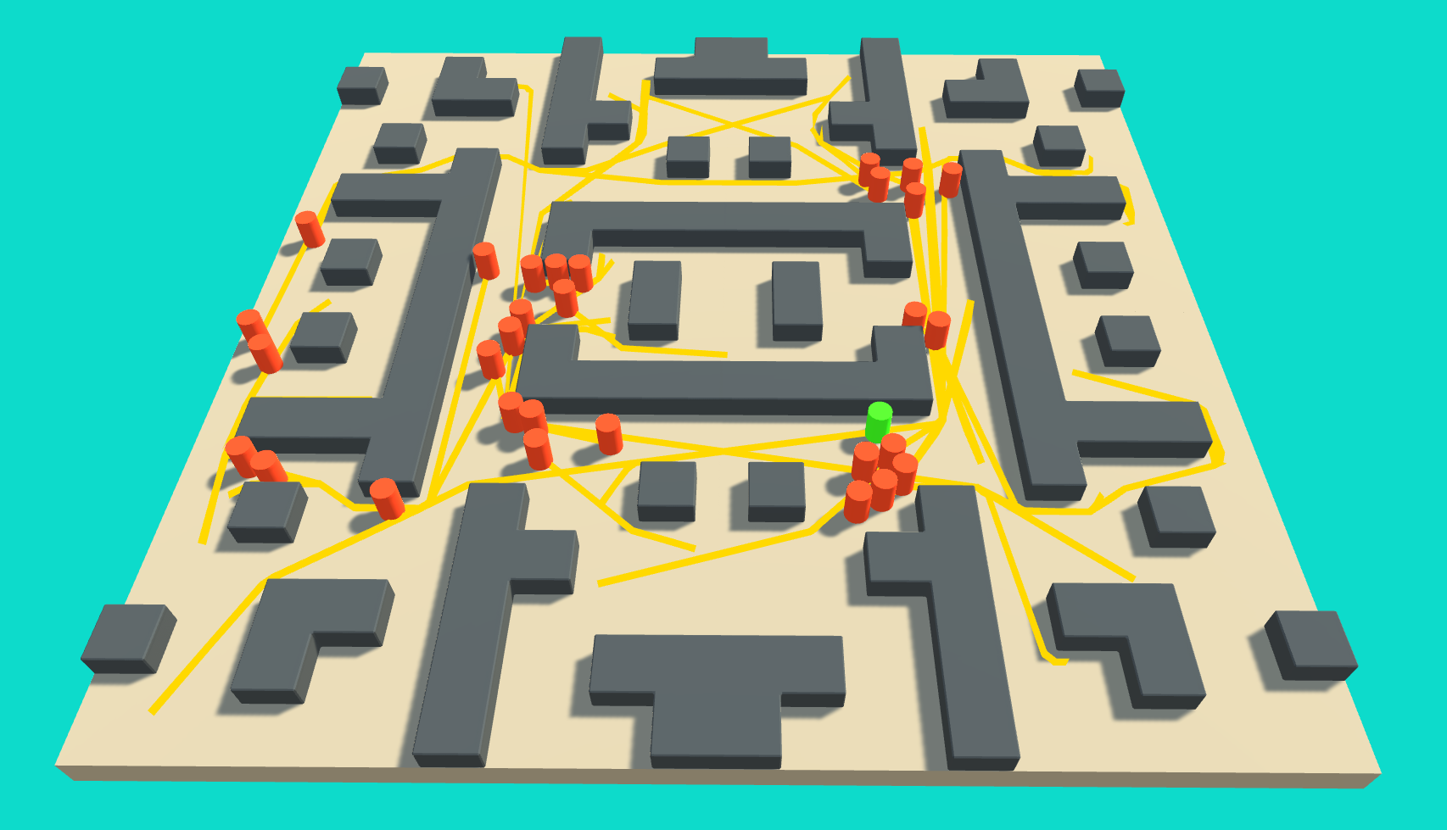
Spawning NPCs
06. NPC Testbed

Slide 61
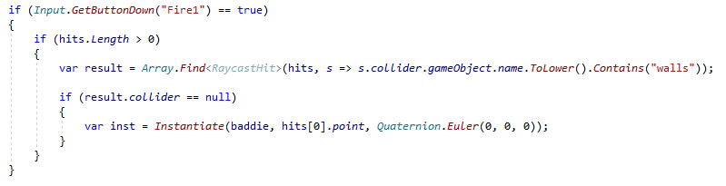
Spawning NPCs
06. NPC Testbed
Create a ‘levelController’ object that will control what’s going on
As there’s no player to worry about
Adds baddies to the game world with LMB
Rework of the original navigation ‘destination’ code
But with added instantiation and a baddie prefab

Slide 62
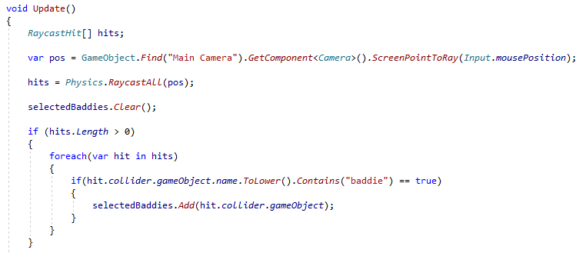
Spawning NPCs
06. NPC Testbed
Create a ‘levelController’ object that will control what’s going on
Removes baddies with RMB
Need to maintain a list of baddies that are in mouse raycast (we’ll use this again later)

Slide 63
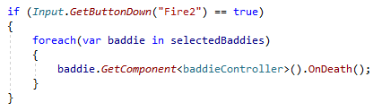
Spawning NPCs
06. NPC Testbed
Create a ‘levelController’ object that will control what’s going on
Removes baddies with RMB
Need to maintain a list of baddies that are in mouse raycast (we’ll use this again later)

Slide 64
Spawning NPCs
06. NPC Testbed
Baddie Controller
Find somewhere to go to
Go there
Change colour when the mouse is on them

Slide 65
Spawning NPCs
06. NPC Testbed
Baddie Controller
Find somewhere to go to
I’ve moved the world to centre it at (0,0,0) as it will make things easier ;)
World is about 20x20, so can use a random range to make positions
And use raycast to see if it’s in a wall or not

Slide 66
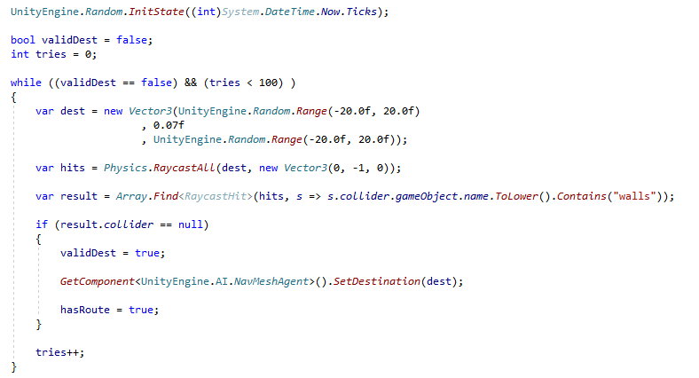
Spawning NPCs
06. NPC Testbed
Baddie Controller
Find somewhere to go to

Slide 67
Spawning NPCs
06. NPC Testbed
Baddie Controller
Find somewhere to go to
As I’m using a while loop, I want to have a get out clause, else the program may hang.
So, we only get 100 goes to find a suitable target
I found (by trial and error) that the NPCs need to be at y=0.7 to stop them from going through the map.
Doing a raycast down, (0,-1,0) will see if they hit the ground or a wall

Slide 68
Spawning NPCs
06. NPC Testbed
Baddie Controller
Find somewhere to go to
Go there
This is a simplified version of the old navigation code
And uses the same state machine framework as before, but with different state names
Change colour when the mouse is on them

Slide 69
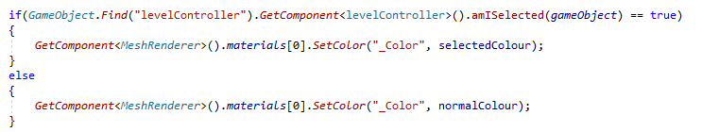
Spawning NPCs
06. NPC Testbed
Baddie Controller
Find somewhere to go to
Go there
Change colour when the mouse is on them
Remember the list of baddies under the mouse pointer?
We can use that information to work out the colour of the baddie

Slide 70

Spawning NPCs
06. NPC Testbed
Baddie Controller
Find somewhere to go to
Go there
Change colour when the mouse is on them
Remember the list of baddies under the mouse pointer?
We can use that information to work out the colour of the baddie
In levelController.cs

Slide 71
Conclusions

Slide 72
Conclusions
(Hopefully) Unity’s physics gives us a lot of scope to:
Make and balance enjoyable weapons
Leverage raycasting to do interesting things
Instantiation & destroy gives us a lot of control over what happens in unity
Relationship between Physics and Navigation should make for good NPC gameplay

Slide 73
Questions?

